Slide 1
Meme-Machine
char broiled; group members:
Matthew Jagielski, Jacob Bieker, Ian Garrett, Theodore LaGrow

Slide 2
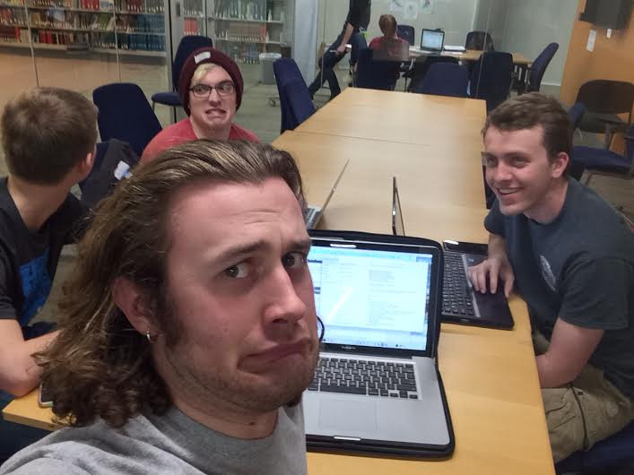
Overview of Project
Code so hard
Memes on fleek

Slide 3
Demonstration
(Hopefully the code works!)

Slide 4
Encryption

Slide 5
Chat Client

Slide 6
Meme Creator

Slide 7
Frontend: Qt, GUI

Slide 8
Risk Management

Slide 9
Questions?

Slide 10
Thank you!

